Slide 1

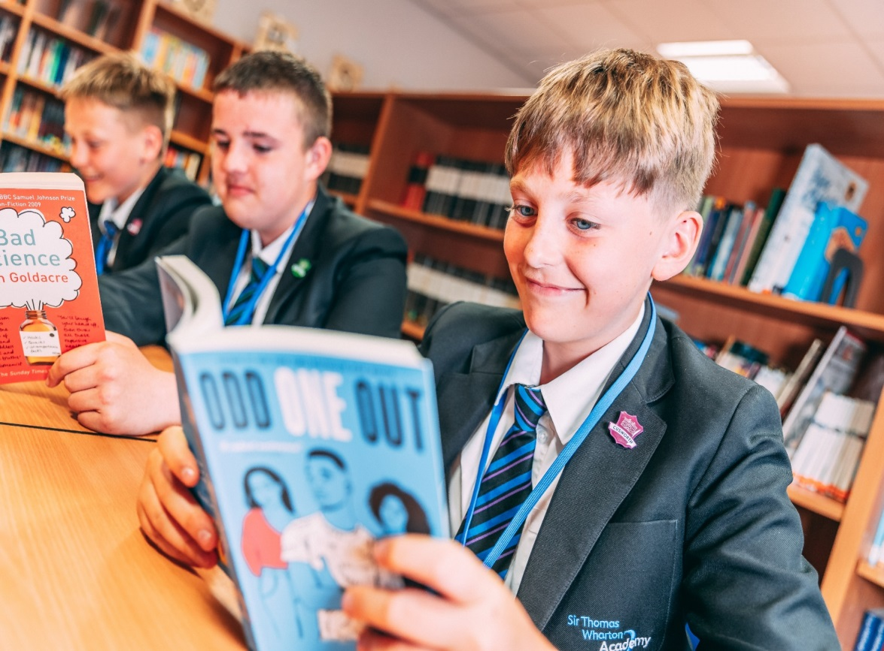
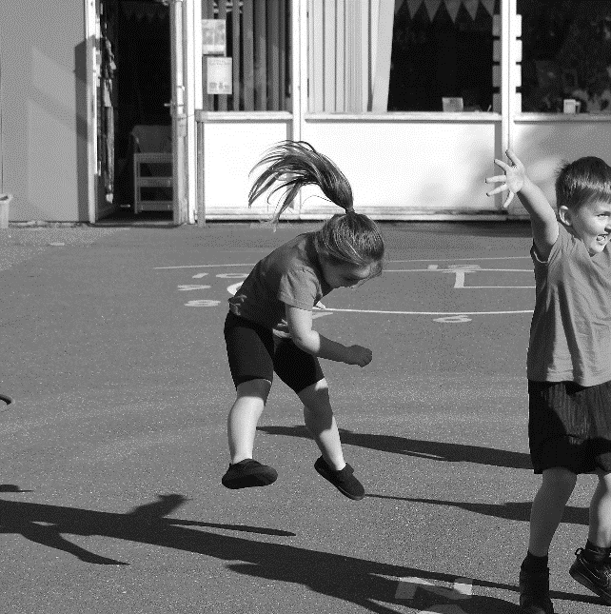
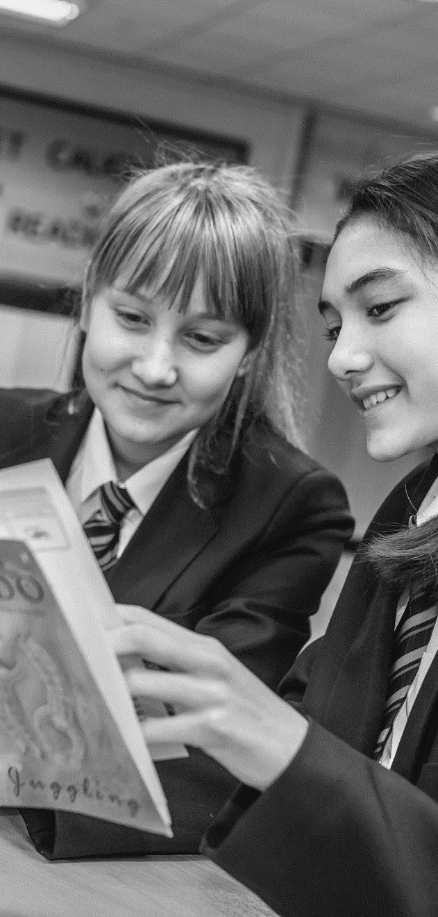
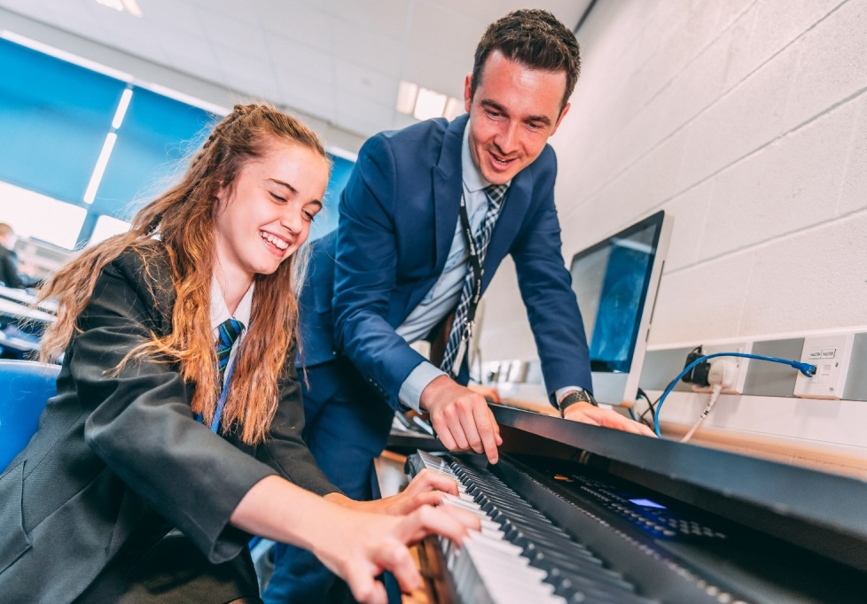

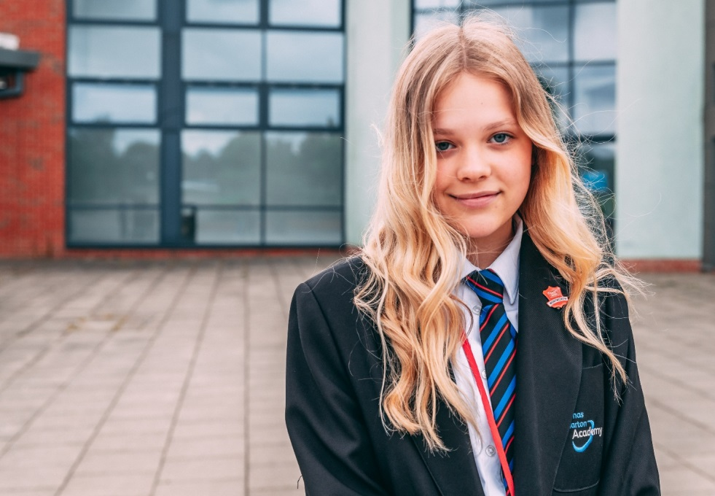

Year 10
Achieve Week 2
Parent/Carer Information Booklet
Monday 10.02.25-Friday14.02.25

Slide 2


Committed to delivering
exceptional learning experiences which enable all students to thrive in a competitive world and lead successful and fulfilling lives.
OUR KEY DRIVERS
THE HIGHEST STANDARDS
Always set and deliver the highest standards: never settle for less.
INVEST TO ACHIEVE
Care about the now: create the very best for your future.
EVERYONE IS VALUED
We are unique individuals working together to be the best.
NO EXCUSES
Create solutions, not excuses.
NEVER GIVE UP
Resilience is essential: self-belief drives improvement.
CULTIVATE YOUR CHARACTER
Qualifications open doors, your character gets you through them.

Slide 3
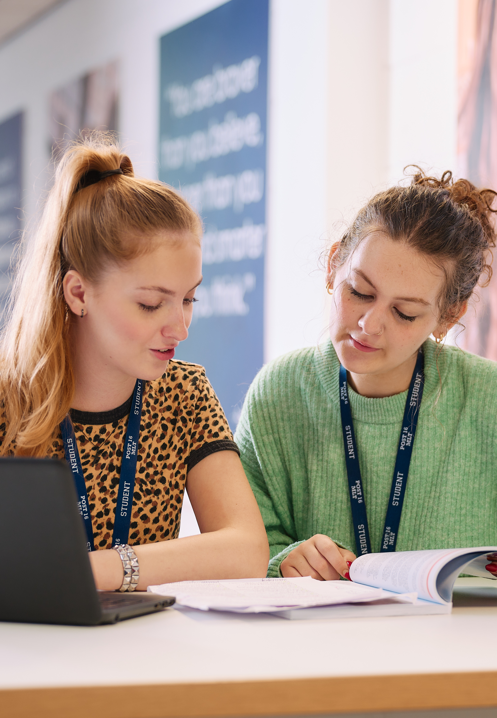
What is Achieve Week?
SIR THOMAS WHARTON ACADEMY | INVEST TO ACHIEVE 2024-2026
What are Achieve Weeks?
The Achieve weeks take place three times throughout the Academic year.
WB 11.11.24
WB 10.02.25
WB 24.03.25
During these three weeks, students in year 10 will follow an alternative, achieve week timetable. This timetable will reflect their options subjects but continue to give them core lessons.
Why do we use Achieve Weeks?
The Achieve weeks give students extended periods of time in each subject area. Some courses require extended periods to support students to achieve their potential. An example of this is BTEC subjects where students are required to complete formal assessments (PSAs) throughout the two-year course. In other courses, the extended periods of time allows staff to ensure depth of knowledge in specific, more challenging areas of the course or time to develop examination technique.

Slide 4
Student Voice
SIR THOMAS WHARTON ACADEMY | INVEST TO ACHIEVE 2024-2026
We have taken student feedback from Achieve week 1 and adapted and improved the plan accordingly for achieve week 2.
You Said
'There was lots of learning in Achieve week 1 and it was a good way to revise.'
'Some sessions were hard being in the same room all day with the same members of staff.'
'The sessions were fast paced and days felt shorter.'
'It would be good to have more sessions on exam technique or live trials.'
'We were able to invest in a subject over a longer period and it was easier to focus as a result.'
'It would be nice to have some rewards or breaks within the days.'
We Did
Increase in the number of practical sessions throughout the week, including off site sessions. (Food, Photography, Technology, art.)
Live trials and examination technique focus in History, Mathematics, English, Science, Geography.
Rotations within history to change location and staff. External speakers in business studies to increase engagement.
PSA/Coursework/NEA focus in some subject areas – with refreshments provided. Increased staffing in some areas for additional support.
Early finish on the Friday instead of P4.

Slide 5
Week Overview
SIR THOMAS WHARTON ACADEMY | INVEST TO ACHIEVE 2024-2026
The overview for Achieve Week 2 is below:
Monday 10.02
Tutor time: Science Achieve
P1-3 Option Block B
P4- Mathematics
Tuesday 11.02
Tutor time: Science Achieve
P1-3 Option Block D
P4- EBACC
Wednesday 12.02
Tutor time: Science Achieve
P1-3 Option Block A
P4- English
Thursday 13.02
Tutor time: Science Achieve
P1-English Achieve, P2: Usual lesson (Ma/Eng), P3: Mathematics Achieve
P4- Science
Friday 14.02
Tutor time: Science Achieve
P1-3 Option Block C
Finish at the end of P3

Slide 6
Subject Information
SIR THOMAS WHARTON ACADEMY | INVEST TO ACHIEVE 2024-2026
What will the students be doing in their subject areas over the course of the week?
Science
During science sessions in tutor time, students will be closing the gap from their most recent assessment.
English:
Students will revise A Christmas Carol with a focus on closing the gap from assessments.
Mathematics
Students will complete a calculator live trial paper in the main hall with trained examiners talking through the questions.
History
Students on rotation across three workshops. Each workshop is on a different section of the course.
These workshops will be run by trained exam board markers.
Geography
Students will close the gap on any misconceptions on topics for paper 1. Students will then complete a live trial in the hall focussing on embedding skills that count for 25% of the course.
French
Students will cover all three tenses and focus on this as this will support in attaining over a grade 4. Students will then develop listening skills throughout the day with additional practice for this paper.

Slide 7
Subject Information
SIR THOMAS WHARTON ACADEMY | INVEST TO ACHIEVE 2024-2026
What will the students be doing in their subject areas over the course of the week?
Dance
Students will be completing both written and practical work for their PSA. This counts towards their final grade.
Sport
Students will be completing tasks 1 and 3 of component 2 of their PSA. These will count towards their final outcomes.
Health and Social Care
Students will be working on their preparation and write up of their 1st Pearson Set assignment. This contributes to 30% of their overall grade.
iMedia:
Completion of Controlled Assessment.
Controlled Assessment accounts for 30% of the final grade.
Music
We will launch component 3 - free composition. The free composition for component 3 is 15% of the qualification and takes an extended period of time to complete. This full day will allow all students to make a strong start to their compositions.
ICT
Students to complete controlled assessments. Controlled assessments count for 60% of their grade.
Computer Science
Students will continue with work on topologies and protocol. This will allow students to have additional time prior to Y10 trials to complete exam technique and revision sessions.
Technology
Students will be working on prototype projects for their formal coursework.
Students will be gaining an understanding of exactly what is expected of them during their actual NEA assessment, which will begin during HT4.
Performing Arts:
Students will spend the time working on Unit 1. This is a practical task which will prepare them for a formal practical exam in HT4.
Food Technology
Students will complete a session on safety theory and then complete a practical on jointing a chicken. This skill is the highest practical skill in their coursework in year 11. Students will then create Chicken Tikka Massala.
Art
Students will continue developing personal projects initiated during the first week of HT3.
Photography
Students are being taken to the Leeds Royal Armouries to capture photographs for the second coursework unit.
Business Studies
Students will be working on course contentto improve examination technique during periods 1 and 2 and then have an external speaker during P3. A financial director is coming to speak to the students.

Slide 8
Parental/Carer Support
SIR THOMAS WHARTON ACADEMY | INVEST TO ACHIEVE 2024-2026
What do you need to do?
Support student attendance throughout the week.
Support students with their investment throughout the week.
Support in maintaining morale throughout the week.
Celebrate any achievements shared by staff through Classcharts.
Support with early finish on Friday (after period 3).

Slide 9


www.stwacademy.com | 01709 864100
Sir Thomas Wharton Academy, Tait Avenue, Edlington, Doncaster, DN12 1HH

